Slide 1
New Investigator Collaborations and Interactions from an Industry Perspective
Marie-Christine Phan, PharmD
Field Medical Advisor, Medical Affairs
August 2022

Slide 2
Disclaimer
This presentation may contain information related to Pfizer products, not included in the Canadian Product Monograph (labelling), or which do not have a marketing authorization. This may include information on medicines in development. This information is being provided for non-promotional purposes.
The content of this presentation is considered by Pfizer Canada Medical to be truthful, accurate, balanced, fair, not misleading and supported by relevant scientific data, including safety data. It is tailored to answer the specific question asked. Pfizer colleagues are required to document the request for this meeting/information and communication of the relevant information.
Marie-Christine Phan is an employee of Pfizer Canada. In line with the Innovative Medicines Canada (IMC) Code of Ethical Practices, this presentation represents a scientific exchange as opposed to a learning activity.

Slide 3
Types of Collaborations for Research
Research
Company-Sponsored Clinical Trials
Independent Initiatives

Slide 4
Types of Collaborations for Research
Research
Company-Sponsored Clinical Trials
Independent Initiatives

Slide 5
Canadian Investigator Contribution to Pfizer R&D
Discovery projects
Phase 1
17
Phase 2
5
Phase 3
8
Oncology Pipeline
Therapeutic Area | # of Studies
Cardiovascular | 4
Gastrointestinal | 2
Genetic Diseases | 1
Hematology | 7
Immunology | 3
Inflammation | 8
Metabolic Disease | 3
Oncology | 41
Vaccines | 3
*Data as of July 2022.

Slide 6
Company-Sponsored Clinical Trial
Implementation Steps
Country Outreach
Site Nomination
Site
Selection
Feasibility

Slide 7
Pfizer Investigator Training Program

Slide 8
Types of Collaborations for Research
Research
Company-Sponsored Clinical Trials
Independent Initiatives

Slide 9
Independent Initiatives
Pfizer supports the global healthcare community’s independent initiatives (e.g., research, quality improvement, or education) to improve patient outcomes in areas of unmet medical need that are aligned with Pfizer’s areas of interest.
Types of initiatives include, but are not limited to:
Investigator-Sponsored Research (ISR): A grant that supports an independent research study where the investigator or organization is the sponsor of the study and where Pfizer provides financial and/or non-financial support for the development or refinement of specific and defined medical knowledge relating to a Pfizer asset.
General Research: This grant type is used to support research that does not include the study of a Pfizer asset, including health services research unrelated to a Pfizer asset, registry development and/or queries unrelated to a Pfizer asset, and outcomes research unrelated to a Pfizer asset.
Quality Improvement (QI): Type of grant which consists of Pfizer funding to support independent projects for systematic and continuous actions that lead to measurable improvement in health care services and the health status of individuals and targeted patient groups and do not relate to a Pfizer asset.
Competitive Grants Program (or Request for Proposals): Pfizer’s competitive grant program involves a publicly posted Request for Proposal (RFP) that provides detail regarding a specific area of interest and sets timelines for review and approval. Organizations are invited to submit an application addressing the specific gaps in research, practice or care as outlined in the specific RFP.
Independent Medical Education: An independent medical education grant is a type of grant which consists of Pfizer funding for independent medical education activities or initiatives which serve to maintain, develop, or increase the knowledge, skills, and/or professional performance of a healthcare professional (e.g. continuing medical education, continuing health education, continuing education).
Pfizer Independent Health Education Grants and Resources Center | Pfizer Independent Grants | Pfizer

Slide 10
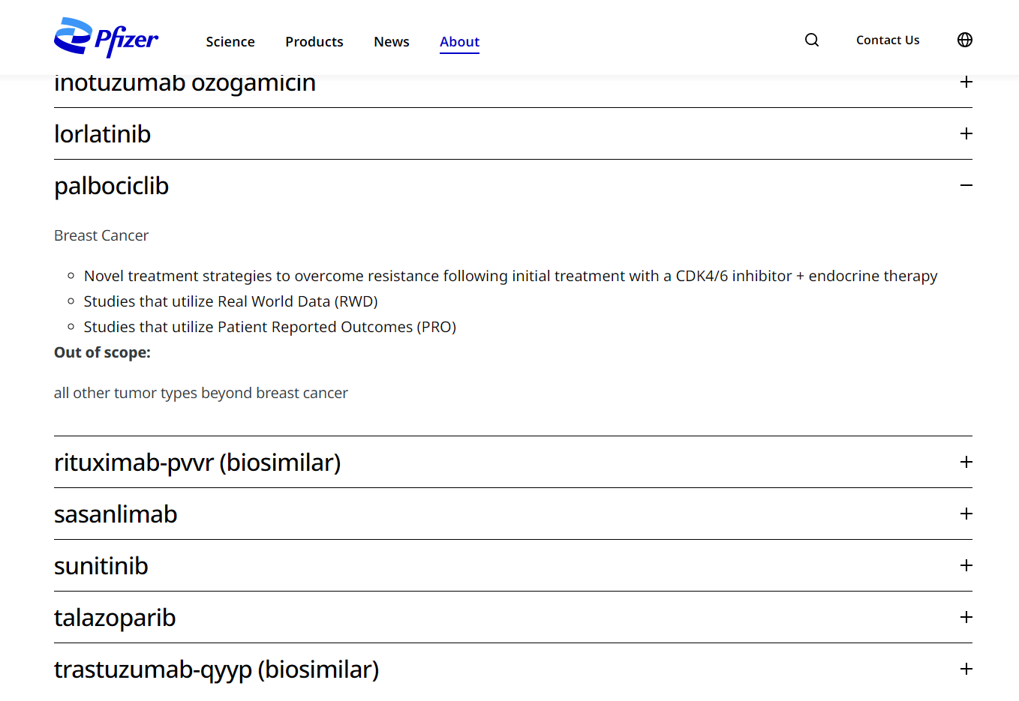
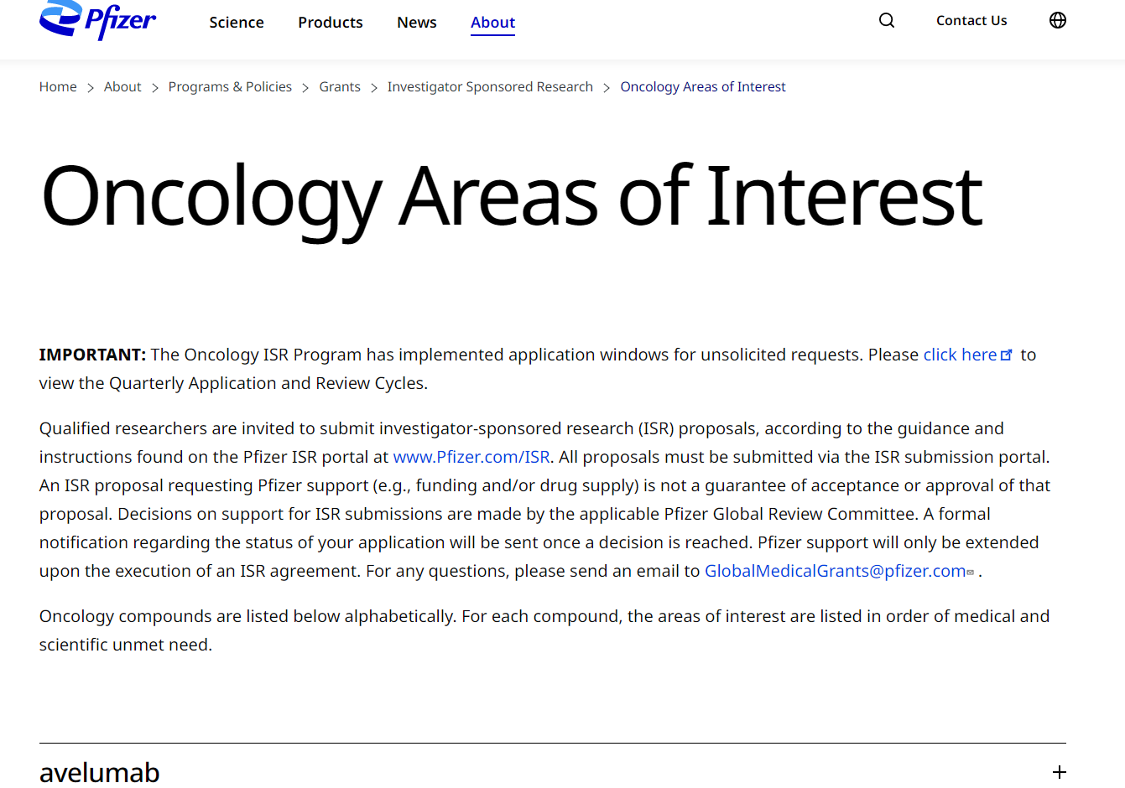
Investigator-Sponsored Research
Oncology Areas of Interest | Pfizer

Slide 11
Request for Proposals (Past)

Slide 12
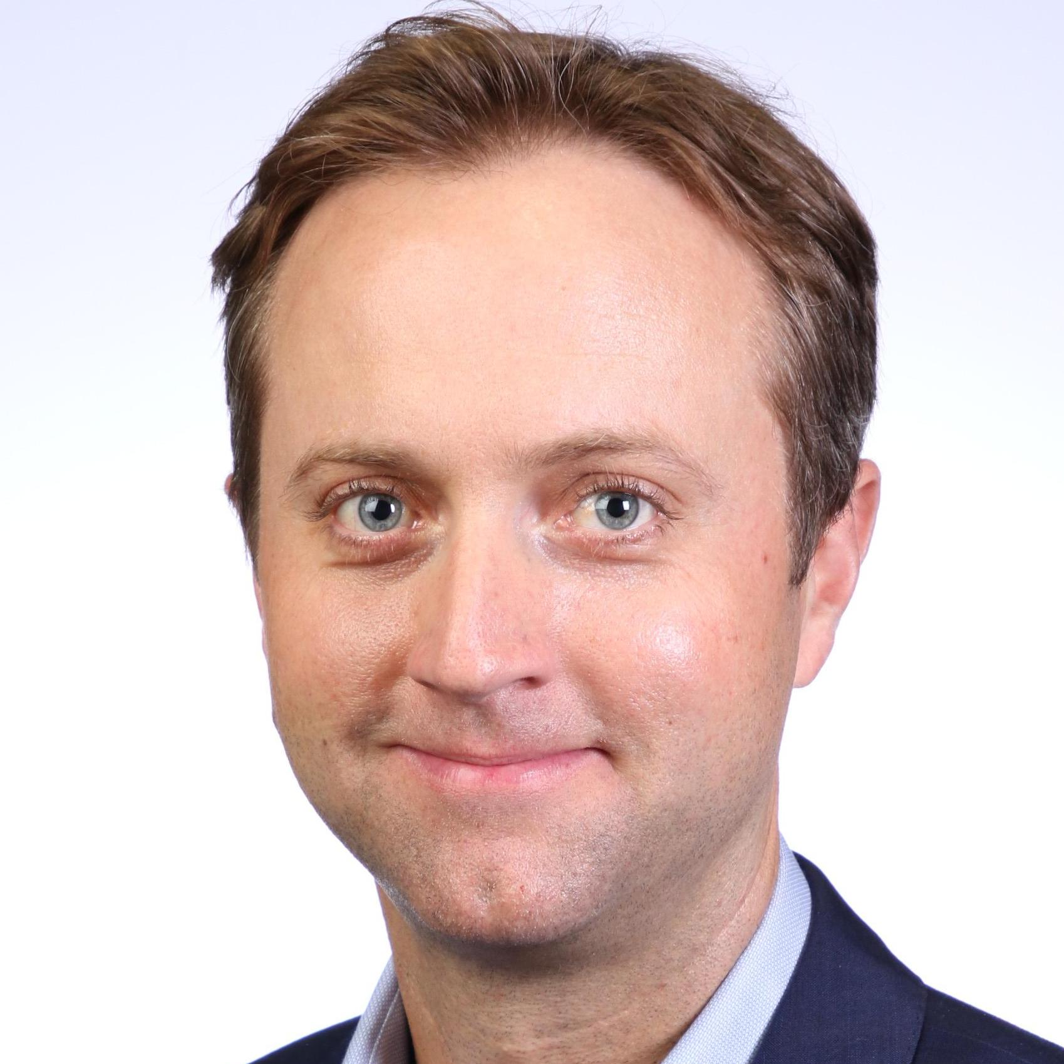
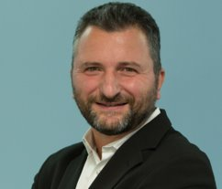
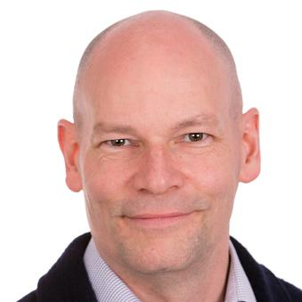
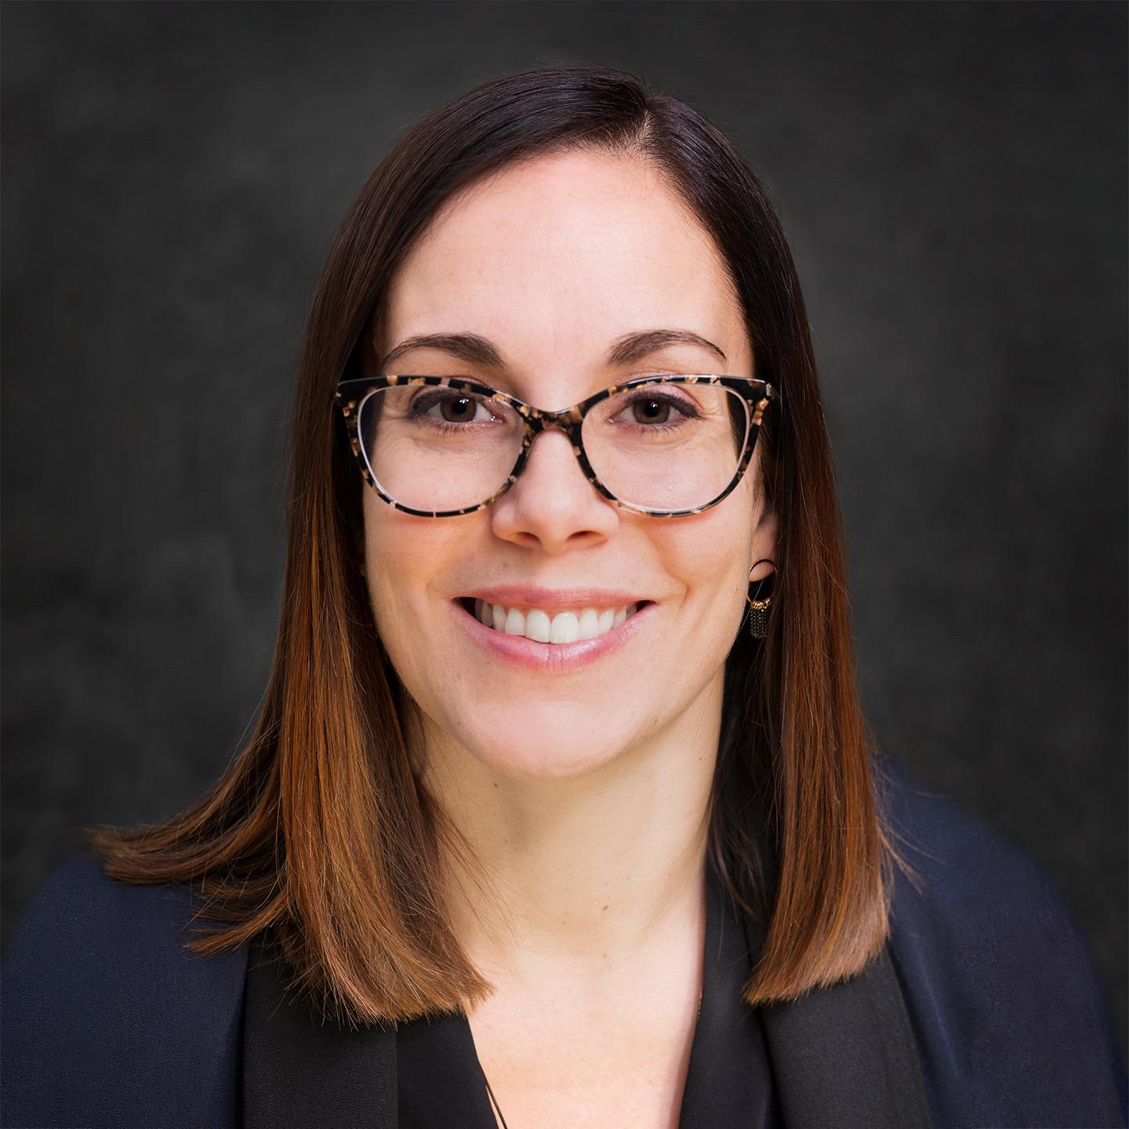
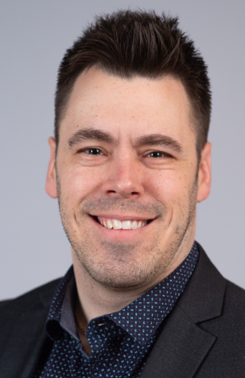
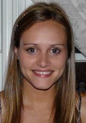
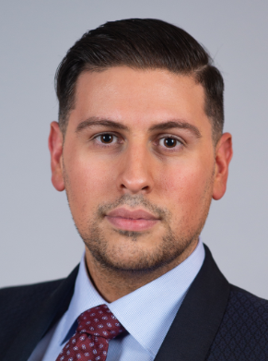
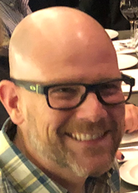
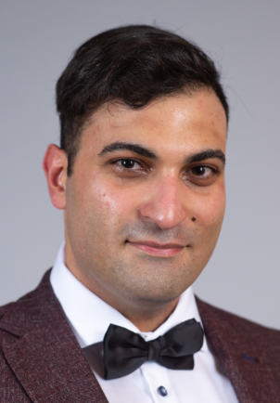
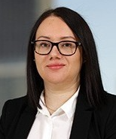
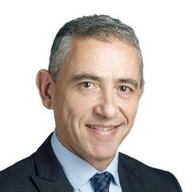
Pfizer Canada Medical Affairs Oncology
Director, Medical Affairs,
Oncology
Andrew Brown
Medical Advisor
Hematology
Jasmine Healy
Medical Advisor
Breast
Guillaume Feugère
Medical Advisor
CRC & Melanoma Andrew Slack
Medical Advisor
Lung & Biosimilars
Martin Rupp
Medical Advisor
GU
Stéphanie St-Jean
Coordinator
Sharron
Matthews-Sinclair
Field Medical Advisor
Team Lead
Josie Visentini
Field Medical Advisor
Breast & GU – Qc/Atl
Jonathan Bertin
Field Medical Advisor
Hematology ON
Stephanie Dorman
Breast/GU
Field Medical Advisor
Breast & GU - ON
Sasha Farina
Field Medical Advisor
Precision Medicine – Qc/Atl
Marie-Christine Phan
Precision Medicine
Hematology
Field Medical Advisor
Breast & GU - West
Jamie Ghuman
Field Medical Advisor
Precision Medicine - West
Andrew Douglas Ficzycz
Field Medical Advisor
Hematology - West
Annie Aftab
Field Medical Advisor
Precision Medicine - ON
Ali Al-Hashimi
Precision Medicine: CRC (Colorectal Carcinoma), Melanoma, and Lung
GU: Genitourinary
Field Medical Advisor
Breast & GU - ON
Tracy Moreira-Lucas
Field Medical Advisor
Hematology – Qc/Atl
Hicham Gonzalez

Slide 13
Thank you!
Marie-Christine Phan
marie-christine.phan@pfizer.com

